Slide 1
K-NEAREST NEIGHBOR
Know what KNN is
Algorithm - steps
Process - body
output
Evaluation methods
Evaluation measures
Application
Data Science Overview

Slide 2
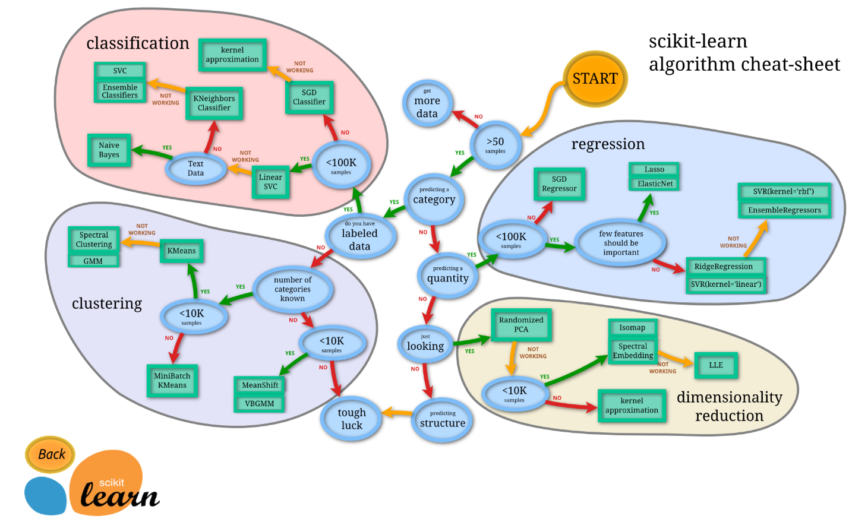
SCIKIT-LEARN – CHEAT SHEET

Slide 3

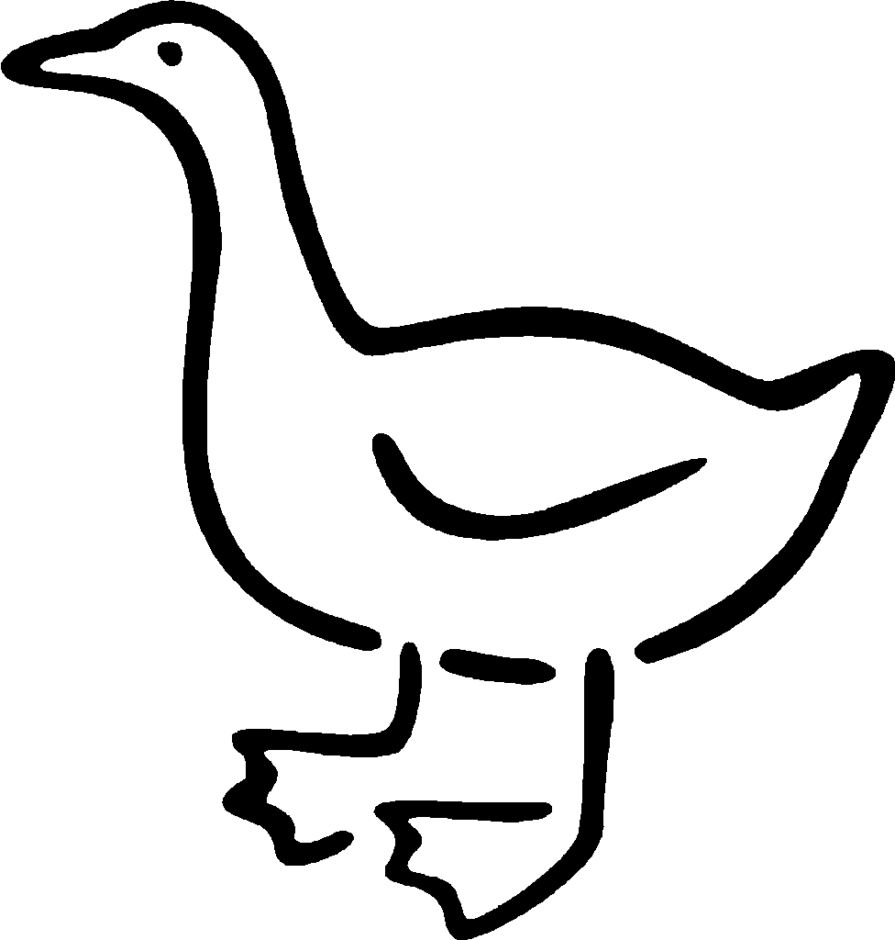
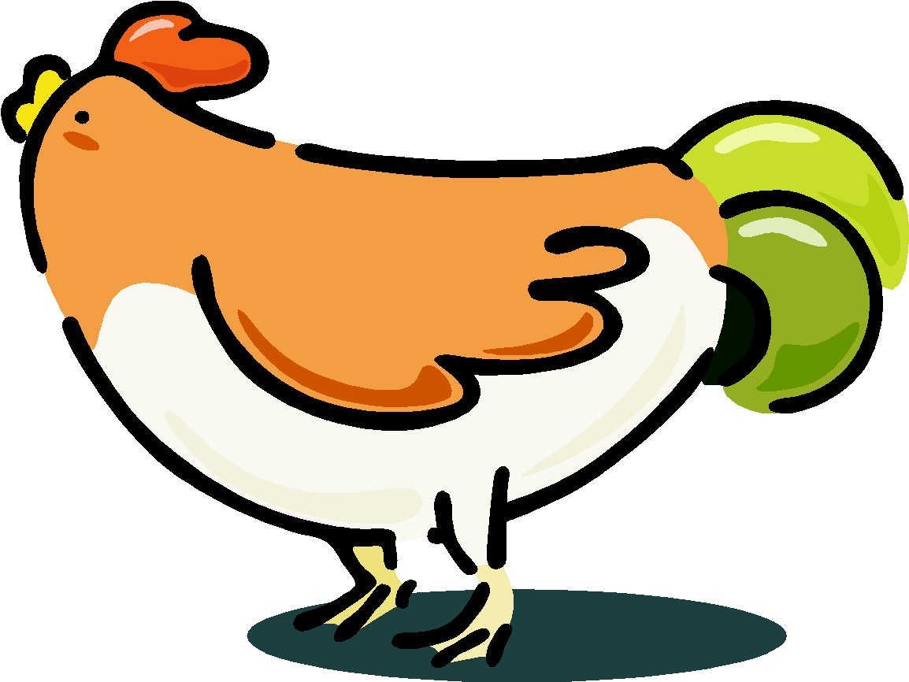



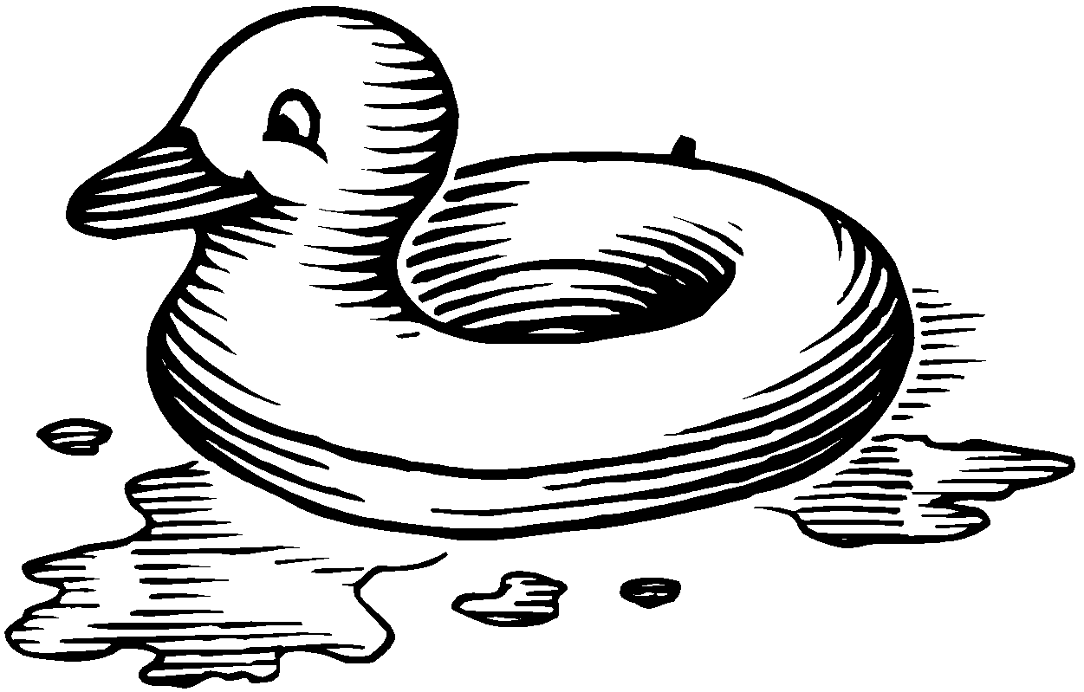
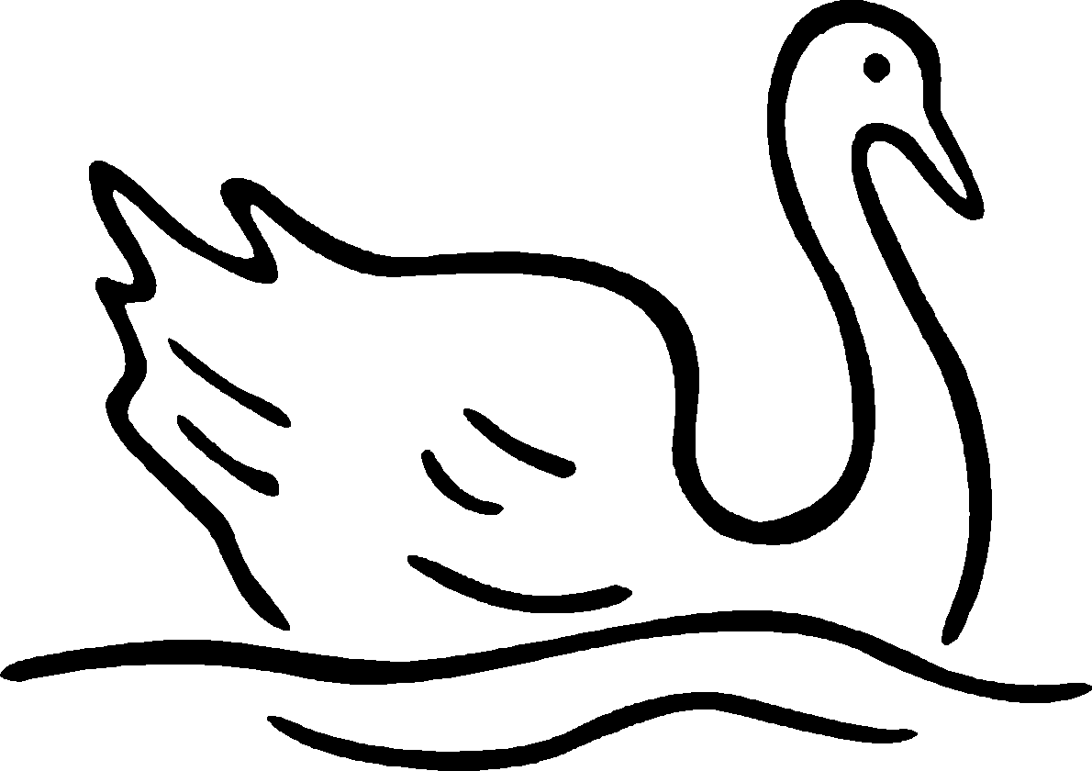
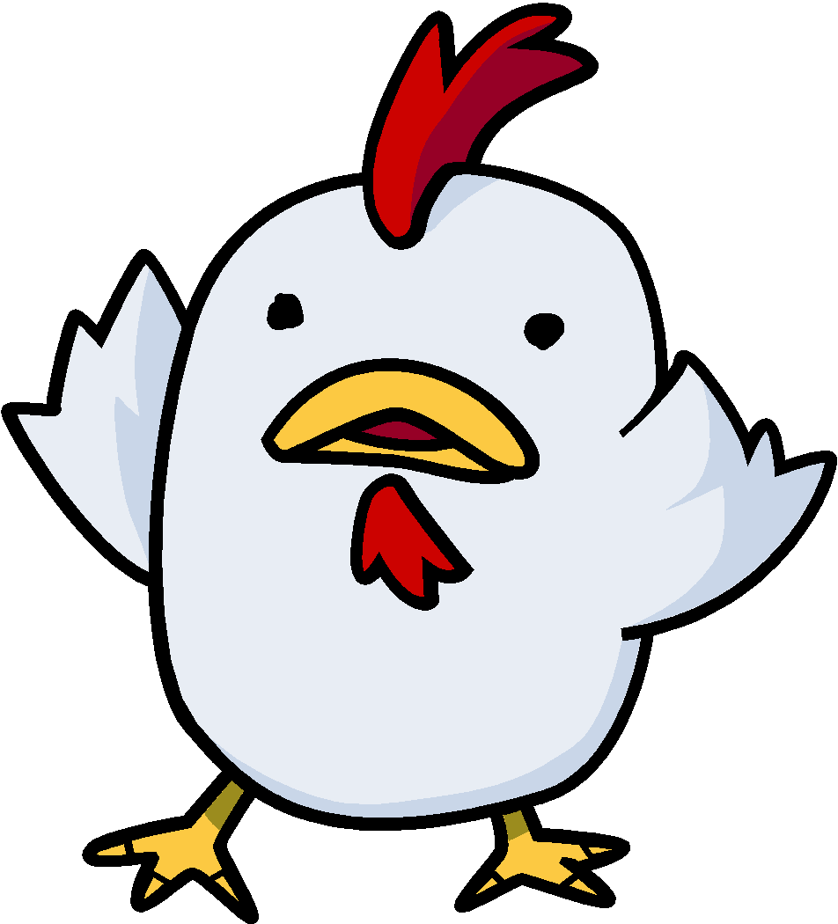

KNN – BASIC IDEA
If it
walks like a duck,
quacks like a duck,
Eats like a duck
then it’s probably a duck !!
Find k-nearest matching birds
Test dataset
Training dataset

Slide 4
KNN – WHAT IT IS
KNN can be used for both classification and regression predictive problems.
KNN falls in the supervised learning family of algorithms.
Informally, this means that we are given a labelled dataset consisting of training observations (x, y) and would like to capture the relationship between x and y.
More formally, our goal is to learn a function h:X→Y so that given an unseen observation x , h(x) can confidently predict the corresponding output y .

Slide 5
KNN – WHAT IT IS
The KNN algorithm is a robust and versatile classifier that is often used as a benchmark for more complex classifiers such as Artificial Neural Networks (ANN) and Support Vector Machines (SVM).
Despite its simplicity, KNN can outperform more powerful classifiers and is used in a variety of applications such as economic forecasting, data compression and genetics.
Lazy Learning Algorithm (instance based learning)
Defer the decision to generalize beyond the training examples till a new test is encountered
Whenever we have a new point to classify, we find its K nearest neighbors from the training data.
The distance is calculated using one of the following measures
Euclidean Distance
Minkowski Distance
Mahalanobis Distance

Slide 6
ASSUMPTIONS
Suitable for applications for which sufficient domain knowledge is available.
This knowledge supports the selection of an appropriate measure of feature set

Slide 7
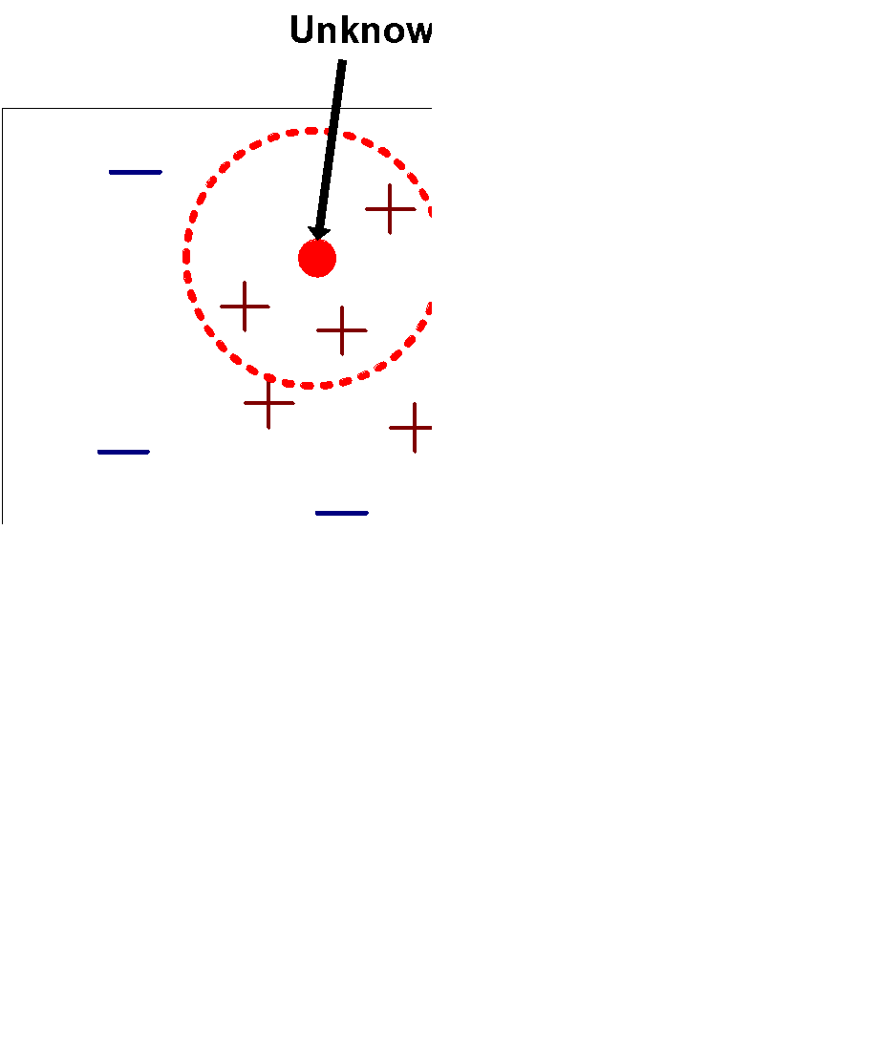
KNN – ALGORITHM (STEPS)
Requires three things
The set of pre-classified training samples
Distance Metric to compute distance between test and all the training samples
The value of k, the number of nearest neighbors to retrieve
To classify an unknown record:
Compute distance to other training samples
Identify k nearest neighbors
Use class labels of nearest neighbors to determine the class label of unknown record (e.g.,
by taking majority vote)
K=3, nearest neighbors, classified as +

Slide 8

DISTANCE CALCULATION
commonly based on the Euclidean distance between a test sample and the specified training samples.
Let x_{i} be an input sample with p features (x_{i1},x_{i2},..., x_{ip}) , n be the total number of input samples (I = 1, 2,..., n) .
The Euclidean distance between sample x_{i} and x_{l} is defined as:

Slide 9
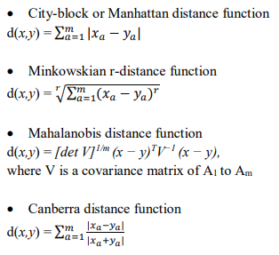
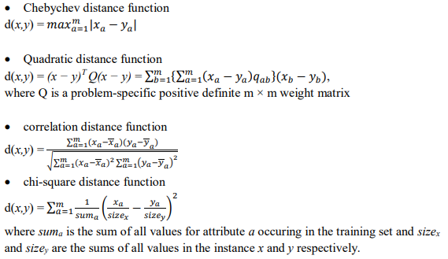
PROXIMITY MEASURES FOR HOMOGENEOUS DATA
The above mentioned distance functions work well for quantitative attributes, but they do not have the solution for nominal, ordinal or heterogeneous data.

Slide 10
OUTPUT
The output depends on whether you use the KNN algorithm for classification or regression.
In KNN classification, the predicted class label is determined by the voting for the nearest neighbors, that is, the majority class label in the set of the selected k instances is returned.
In KNN regression, the average value of the target function values of the nearest neighbors is returned as the predicted value.

Slide 11
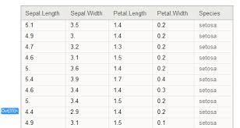
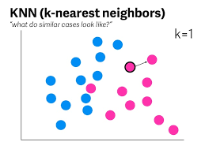


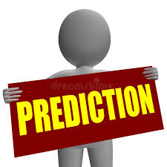
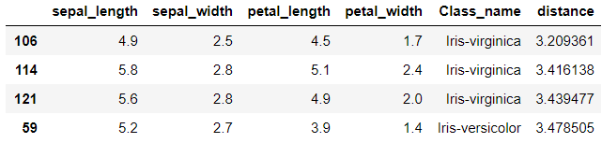
EVALUATION – 1 (INPUT TEST SAMPLE)
Load into
Test sample input
Training dataset
Entire training set considered
Test sample entered externally

Slide 12

EVALUATION – 2 (LEAVE-ONE-OUT CROSS-VALIDATION - LOOCV)
Split into
Training
1 test sample
Training dataset
is a special case of cross-validation method in which each instance is used once as the test case and all other instances are used as the training set.
also called as n-fold cross validation.
utilizes the utmost training instances
but due to its expensive nature it is usually applied to small datasets.

Slide 13

EVALUATION – 3 (HOLDOUT METHOD)
Training
Test sample
Split into
Test
Training dataset
original data set is partitioned into two parts
50-50 or 70-30 or 60-40
randomly divided into the training and test sets
Repeated for each test sample

Slide 14
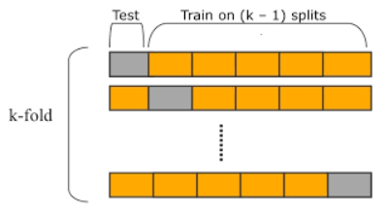
EVALUATION – 4 (CROSS-VALIDATION METHOD) - STRATIFIED
Test sample
Split into
Training dataset
Repeated for each fold
Popular choices for K are 3, 5 and 10 as they’re manageable computationally
The cross-validation method is used with moderate datasets having instances around hundreds or more.
Repeated for each test sample

Slide 15
SKLEARN - KNEIGHBORSCLASSIFIER
class sklearn.neighbors.KNeighborsClassifier(n_neighbors=5,
weights=’uniform’,
algorithm=’auto’,
leaf_size=30,
p=2,
metric=’minkowski’,
metric_params=None,
n_jobs=1, **kwargs)
‘n_neighbors‘ are the number of neighbors that will vote for the class of the target point
default is 5.
An odd number is preferred to avoid any tie.

Slide 16
SKLEARN - KNEIGHBORSCLASSIFIER
class sklearn.neighbors.KNeighborsClassifier(n_neighbors=5, weights=’uniform’, algorithm=’auto’, leaf_size=30, p=2, metric=’minkowski’, metric_params=None, n_jobs=1, **kwargs)
‘weights‘ parameter has two choices: ‘uniform‘ and ‘distance‘.
For the ‘uniform‘ weight, each of the k neighbors has equal vote whatever its distance from the target point.
If the weight is ‘distance‘ then voting weightage or importance varies by inverse of distance; those points who are nearest to the target point have greater influence than those who are farther away.
Default is ‘uniform‘

Slide 17
SKLEARN - KNEIGHBORSCLASSIFIER
class sklearn.neighbors.KNeighborsClassifier(n_neighbors=5, weights=’uniform’, algorithm=’auto’, leaf_size=30, p=2, metric=’minkowski’, metric_params=None, n_jobs=1, **kwargs)
Parameter ‘metric‘ decides how distances are calculated in space.
Euclidean distance
Manhattan distance are also used.
A general formulation of distance metric is ‘minkowski’ distance. (default, along with p=2)
Metrics intended for real-valued vector spaces:
identifier | class name | args | distance function
“euclidean” | EuclideanDistance |  | sqrt(sum((x - y)^2))
“manhattan” | ManhattanDistance |  | sum(|x - y|)
“chebyshev” | ChebyshevDistance |  | max(|x - y|)
“minkowski” | MinkowskiDistance | p | sum(|x - y|^p)^(1/p)
“wminkowski” | WMinkowskiDistance | p, w | sum(w * |x - y|^p)^(1/p)
“seuclidean” | SEuclideanDistance | V | sqrt(sum((x - y)^2 / V))
“mahalanobis” | MahalanobisDistance | V or VI | sqrt((x - y)' V^-1 (x - y))

Slide 18
SKLEARN - KNEIGHBORSCLASSIFIER
Metrics intended for two-dimensional vector spaces:
Note that the haversine distance metric requires data in the form of [latitude, longitude] and both inputs and outputs are in units of radians.
identifier | class name | distance function
“haversine” | HaversineDistance | 2 arcsin(sqrt(sin^2(0.5*dx)cos(x1)cos(x2)sin^2(0.5*dy)))

Slide 19
SKLEARN - KNEIGHBORSCLASSIFIER
Metrics intended for integer-valued vector spaces: Though intended for integer-valued vectors, these are also valid metrics in the case of real-valued vectors.
identifier | class name | distance function
“hamming” | HammingDistance | N_unequal(x, y) / N_tot
“canberra” | CanberraDistance | sum(|x - y| / (|x| + |y|))
“braycurtis” | BrayCurtisDistance | sum(|x - y|) / (sum(|x|) + sum(|y|))

Slide 20
SKLEARN - KNEIGHBORSCLASSIFIER
Metrics intended for boolean-valued vector spaces: Any nonzero entry is evaluated to “True”. In the listings below, the following abbreviations are used:
N : number of dimensions
NTT : number of dims in which both values are True
NTF : number of dims in which the first value is True, second is False
NFT : number of dims in which the first value is False, second is True
NFF : number of dims in which both values are False
NNEQ : number of non-equal dimensions, NNEQ = NTF + NFT
NNZ : number of nonzero dimensions, NNZ = NTF + NFT + NTT
identifier | class name | distance function
“jaccard” | JaccardDistance | NNEQ / NNZ
“matching” | MatchingDistance | NNEQ / N
“dice” | DiceDistance | NNEQ / (NTT + NNZ)
“kulsinski” | KulsinskiDistance | (NNEQ + N - NTT) / (NNEQ + N)
“rogerstanimoto” | RogersTanimotoDistance | 2 * NNEQ / (N + NNEQ)
“russellrao” | RussellRaoDistance | NNZ / N
“sokalmichener” | SokalMichenerDistance | 2 * NNEQ / (N + NNEQ)
“sokalsneath” | SokalSneathDistance | NNEQ / (NNEQ + 0.5 * NTT)

Slide 21
DISTANCE FUNCTION – WHEN TO USED WHAT
identifier | Purpose
euclidean | For numeric features Symmetric, treats all dimensions equally. Sensitive to extreme values | sqrt(sum((x - y)^2))
Hamming | For categorical features | N_unequal(x, y) / N_tot
Minkowski | Default (equivalent of Euclidean) If p =2 , Euclidean If p=1, Manhattan | sum(|x - y|^p)^(1/p)
Manhattan |  | sum(|x - y|)
mahalanobis |  | sqrt((x - y)' V^-1 (x - y))

Slide 22
SKLEARN - KNEIGHBORSCLASSIFIER
class sklearn.neighbors.KNeighborsClassifier(n_neighbors=5, weights=’uniform’, algorithm=’auto’, leaf_size=30, p=2, metric=’minkowski’, metric_params=None, n_jobs=1, **kwargs)
Parameter ‘n_jobs‘ - The number of parallel jobs to run for neighbors search.
If -1, then the number of jobs is set to the number of CPU cores.
Default is 1

Slide 23
SKLEARN - KNEIGHBORSCLASSIFIER
class sklearn.neighbors.KNeighborsClassifier(n_neighbors=5, weights=’uniform’, algorithm=’auto’, leaf_size=30, p=2, metric=’minkowski’, metric_params=None, n_jobs=1, **kwargs)
3 different nearest neighbors algorithms:
BallTree,
KDTree, and
a brute-force
The choice of neighbors search algorithm is controlled through the keyword 'algorithm', which must be one of ['auto', 'ball_tree', 'kd_tree', 'brute’].
When the default value 'auto' is passed, the algorithm attempts to determine the best approach from the training data.

Slide 24
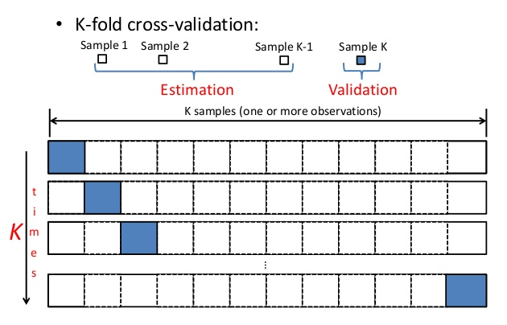
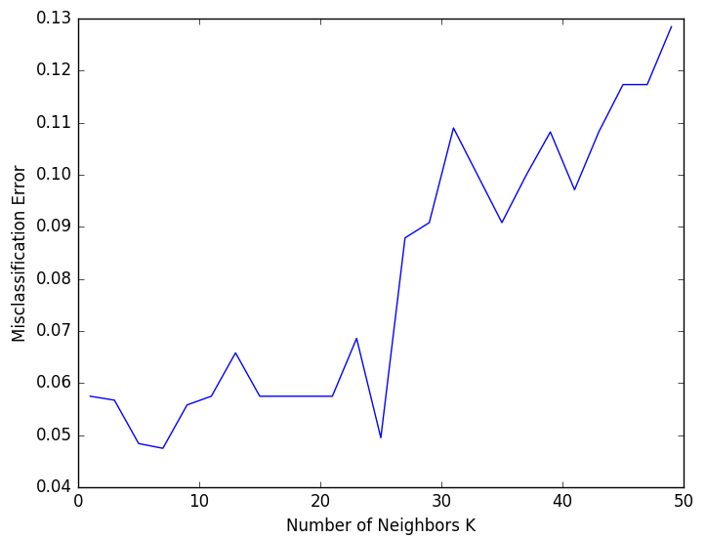
BEST K (NEIGHBORS)
10-fold cross validation tells us that K=7 results in the lowest validation error.

Slide 25
K - VALUE
In general, the optimal value for K will depend on the bias-variance tradeoff.
A small value for K provides the most flexible fit, which will have low bias but high variance.
This variance is due to the fact that the prediction in a given region is entirely dependent on just one observation.
In contrast, larger values of K provide a smoother and less variable fit;
the prediction in a region is an average of several points, and so changing one observation has a smaller effect

Slide 26
CATEGORICAL VARIABLES
Ordinal (along with other continuous variables) | Nominal
Create dummy variables out of a categorical variable and include them instead of original categorical variable. For example, a categorical variable named “Department” has 5 unique levels / categories. So we will create 5 dummy variables. Each dummy variable has 1 against its department and else 0. | KNN does not do well in this case

Slide 27
PROS AND CONS
Pros:
No assumptions about data — useful, for example, for nonlinear data
Simple algorithm — to explain and understand/interpret
High accuracy (relatively) — it is pretty high but not competitive in comparison to better supervised learning models
Versatile — useful for classification or regression
Cons:
Computationally expensive — because the algorithm stores all of the training data
High memory requirement
Stores all (or almost all) of the training data
Prediction stage might be slow (with big N)
Sensitive to irrelevant features and the scale of the data

Slide 28
SCIKIT - KNN – TREE TUNING
Algorithms
Brute Force | most naive neighbor search implementation involves the brute-force computation of distances between all pairs of points in the dataset competitive for small data samples as the number of samples grows, the brute-force approach quickly becomes infeasible {algorithm = 'brute’}
K-D Tree | these structures attempt to reduce the required number of distance calculations by efficiently encoding aggregate distance information for the sample The basic idea is that if point A is very distant from point B and point B is very close to point C, then we know that points A and C are very distant,!!! KD tree approach is very fast for low-dimensional neighbors searches, it becomes inefficient as grows very large {algorithm = 'kd_tree’}
Ball Tree | Faster than K-D tree {algorithm = 'ball_tree’}

Slide 29
BRUTE FORCE
The most naive neighbor search implementation involves the brute-force computation of distances between all pairs of points in the dataset
Efficient brute-force neighbors searches can be very competitive for small data samples. However, as the number of samples grows, the brute-force approach quickly becomes infeasible
algorithm = 'brute’
'Brute Force' implementation consists of 3 stages
1st stage is to calculate all of the `distances' from each test point to every reference point in the training set
2nd stage is to sort these distances and select the k objects that are the closest
3rd stage is final classification

Slide 30
SPEEDING UP KNN – USING KD-TREE
K-Dimensional Tree, Invented in 1970s by Jon Bentley
Name originally meant “3d-trees, 4d-trees, etc” where k was the # of dimensions, A k-dimensional tree is a binary tree.
In the generic k-NN model, each time a prediction is to be made for a test point, first this test point’s distance from all other points is calculated and then only nearest k-points can be discovered for voting.
This approach is also known as brute-force approach.
With increasing data volume and dimensionality, this repeated distance calculations is COSTLY
To speed up and to avoid measuring distances from all the points in the data set, some prepossessing of training data is done.

Slide 31
KD-TREE – EXAMPLE CONSTRUCTION
Consider a three dimensional (training) data set.
3 attributes ‘a’, ‘b’ and ‘c’.
Among the three, attribute ‘b’ has the greatest variance.
We sort the data set on the attribute ‘b’
Divide it into 2 parts at the median.
Refer to the excel sheet
 | a | b | c
 | 22 | 38 | 21
 | 4 | 8 | 6
 | 2 | 14 | 3
 | 8 | 20 | 12
 | 10 | 26 | 18
 | 12 | 32 | 15
 | 18 | 56 | 33
 | 16 | 44 | 27
 | 20 | 50 | 24
 | 14 | 62 | 30
 | 6 | 2 | 9
Mean | 12 | 32 | 18
Variance | 44 | 396 | 99
SD | 6.63 | 19.90 | 9.95
 | a | b | c
 | 6 | 2 | 9
 | 4 | 8 | 6
 | 2 | 14 | 3
 | 8 | 20 | 12
 | 10 | 26 | 18
 | 12 | 32 | 15
 | 22 | 38 | 21
 | 16 | 44 | 27
 | 20 | 50 | 24
 | 18 | 56 | 33
 | 14 | 62 | 30
Median | 12 | 32 | 18
Column ‘b’ has max variance
median is at (12,32,15).

Slide 32
BALL TREE
In computer science, a ball tree, or metric tree, is a space partitioning data structure for organizing points in a multi-dimensional space.
The ball tree gets its name from the fact that it partitions data points into a nested set of hyperspheres known as "balls".
The resulting data structure has characteristics that make it useful for a number of applications, most notably nearest neighbor search.

Slide 33
CHOICE OF TREE ALGORITHM
The optimal algorithm for a given dataset is a complicated choice and depends on a number of factors:
number of samples (i.e. n_samples) and dimensionality (i.e. n_features).
For small data sets, brute force algorithms can be more efficient than a tree-based approach.
Both KDTree and BallTree address this through providing a leaf size parameter: this controls the number of samples at which a query switches to brute-force.
number of neighbors
Brute force query time is largely unaffected by the value of k

Slide 34
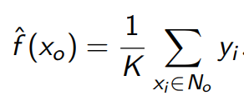
KNN REGRESSOR
Assume a value for the number of nearest neighbors K and a prediction point x_{o}.
KNN identifies the training observations No closest to the prediction point x_{o}.
KNN estimates f (x_{o}) using the average of all the responses in No, i.e.

Slide 35
KNN – SOME CONSIDERATIONS
considerations | Comments
Parametric or non parametric ? | KNN is a non-parametric machine learning algorithm
Features normality? | Non-parametric means that KNN does not make assumptions about the distribution of the data it is modeling
Categorical features? | For binary and ordinal, converting to numbers makes sense. *** But for nominal, it does not make sense.
Normalizing features? | Required
Affect of outliers? | Needs to be removed
All attributes are equally important | KNN assumes that all attributes are equally important. Feature Engg required
Affect of features collinearity | KNN makes no assumption about the data.

Slide 36
KNN – SOME CONSIDERATIONS
considerations | Comments
Noisy instances | Noisy instances are instances with a bad target class. If the dataset is noisy , then by accident we might find an incorrectly classified training instance as the nearest one to our test instance. Majority vote over K nearest neighbors instances . Identification of reliable “prototypes” for each class
Identify noisy data | By changing the k, if the accuracy changes a lot between various settings of k it's may be a noisy data set
Mixed data types (continuous and categorical) | Use GOWER method for distance calculation
KNN for only categorical variables

Slide 37
APPLICATION
Text mining
k-NN is often used in search applications where we are looking for “similar” items;
when our task is some form of “find items similar to this one”.
searching for semantically similar documents (i.e., documents containing similar topics), this is referred to as Concept Search
Recommender Systems - If you know a user likes a particular item, then you can recommend similar items for them.
To find similar items, compare the set of users who like each item—
recommending products, media to consume, or even ‘recommending’ advertisements to display to a user!

Slide 38
APPLICATION
Finance
Stock market forecasting
Best time to purchase the stocks
what stocks to purchase.
Forecasting stock market: Predict the price of a
stock, on the basis of company performance
measures and economic data.
• Currency exchange rate
• Bank bankruptcies
• Understanding and managing financial risk
• Trading futures
• Credit rating
• Loan management
• Bank customer profiling
• Money laundering analyses
Medicine
Predict whether a patient, hospitalized due to a heart attack, will have a second heart attack. The prediction is to be based on demographic, diet and clinical measurements for that patient.
Estimate the amount of glucose in the blood of a diabetic person, from the infrared absorption spectrum of that person’s blood.
Identify the risk factors for prostate cancer, based on clinical and demographic variables.

Slide 39
WEIGHTED K NEAREST NEIGHBOR
Approach 1
Associate weights with the attributes
Assign weights according to the relevance of attributes
Assign random weights
Calculate the classification error
Adjust the weights according to the error
Repeat till acceptable level of accuracy is reached

Slide 40
WEIGHTED K NEAREST NEIGHBOR
Approach 2
Backward Elimination
Starts with the full set of features and greedily remove the one that most improves performance, or degrades performance slightly

Slide 41
WEIGHTED K NEAREST NEIGHBOR
Approach 3 (Instance Weighted)
Gradient Descent
Assign random weights to all the training instances
Train the weights using Cross Validation

Slide 42
WEIGHTED K NEAREST NEIGHBOR
Approach 4 (Attribute Weighted)
Gradient Descent
Assign random weights to all the instances
Train the weights using Cross Validation

Slide 43
DEALING WITH CATEGORICAL DATA
Not all data has numerical values. Here are examples of categorical data:
The blood type of a person: A, B, AB or O.
The state that a resident of the INDIA lives in.
T-shirt size. XL > L > M
T-shirt color
Rating

Slide 44
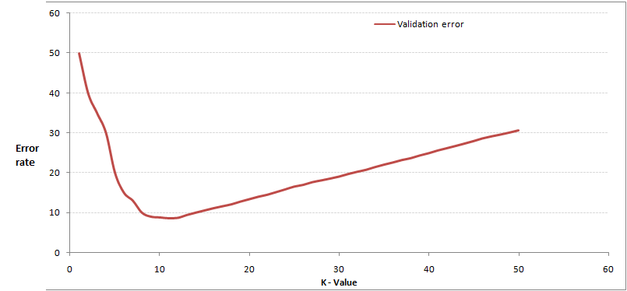
QS
k-NN algorithm does more computation on test time rather than train time.
A) TRUE
B) FALSE
2. In the image below, which would be the best value for k assuming that the algorithm you are using is k-Nearest
Neighbor.

Slide 45
QS
Which of the following distance metric can not be used in k-NN?
A) Manhattan
B) Minkowski
C) Tanimoto
D) Jaccard
E) Mahalanobis
F) All can be used
Which of the following option is true about k-NN algorithm?
A) It can be used for classification
B) It can be used for regression
C) It can be used in both classification and regression

Slide 46
QS
Which of the following statement is true about k-NN algorithm?
k-NN performs much better if all of the data have the same scale
k-NN works well with a small number of input variables (p), but struggles when the number of inputs is very large
k-NN makes no assumptions about the functional form of the problem being solved
A) 1 and 2
B) 1 and 3
C) Only 1
D) All of the above

Slide 47
QS
Which of the following is true about Manhattan distance?
A) It can be used for continuous variables
B) It can be used for categorical variables
C) It can be used for categorical as well as continuous
D) None of these
Which of the following distance measure do we use in case of categorical variables in k-NN?
Hamming Distance
Euclidean Distance
Manhattan Distance

Slide 48
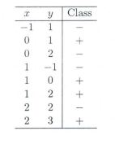
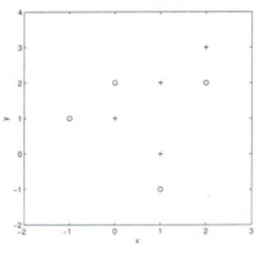
QS
Suppose, you have given the following data where x and y are the 2 input variables and Class is the dependent variable.
you want to predict the class of new data point x=1 and y=1 using Euclidian distance in 3-NN. In which class this data point belong to?
A) + Class
B) – Class
C) Can’t say
D) None of these
you are now want use 7-NN instead of 3-KNN which of the following x=1 and y=1 will belong to?
scatter plot which shows the above data in 2D space.

Slide 49
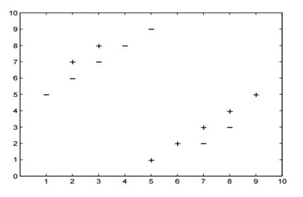
QS
Suppose you have given the following 2-class data where “+” represent a positive class and “-” is represent negative class.
Which of the following value of k in k-NN would minimize the leave one out cross validation accuracy?
A) 3
B) 5
C) Both have same
D) None of these

Slide 50
QS
Which of the following will be true about k in k-NN in terms of Bias?
A) When you increase the k the bias will be increases
B) When you decrease the k the bias will be increases
C) Can’t say
D) None of these
Which of the following will be true about k in k-NN in terms of variance?
A) When you increase the k the variance will increases
B) When you decrease the k the variance will increases
C) Can’t say
D) None of these

Slide 51
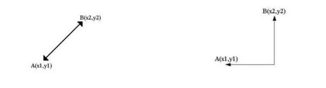
QS
The following two distances(Euclidean Distance and Manhattan Distance) have been given to you which generally we used in K-NN algorithm. These distance are between two points A(x1,y1) and B(x2,Y2).
Your task is to tag the both distance by seeing the following two graphs. Which of the following option is true about below graph ?
A) Left is Manhattan Distance and right is Euclidean Distance
B) Left is Euclidean Distance and right is Manhattan Distance
C) Neither left or right are a Manhattan Distance
D) Neither left or right are a Euclidian Distance

Slide 52
QS
When you find noise in data which of the following option would you consider in k-NN?
A) I will increase the value of k
B) I will decrease the value of k
C) Noise can not be dependent on value of k
D) None of these
In k-NN it is very likely to overfit due to the curse of dimensionality. Which of the following option would you consider to handle such problem?
Dimensionality Reduction
Feature selection
A) 1
B) 2
C) 1 and 2
D) None of these

Slide 53
QS
Below are two statements given. Which of the following will be true both statements?
k-NN is a memory-based approach is that the classifier immediately adapts as we collect new training data.
The computational complexity for classifying new samples grows linearly with the number of samples in the training dataset in the worst-case scenario.
A company has build a kNN classifier that gets 100% accuracy on training data. When they deployed this model on client side it has been found that the model is not at all accurate. Which of the following thing might gone wrong?
Note: Model has successfully deployed and no technical issues are found at client side except the model performance
A) It is probably a overfitted model
B) It is probably a underfitted model
C) Can’t say
D) None of these

Slide 54
QS
You have been given the following 2 statements, find which of these option is/are true in case of k-NN?
In case of very large value of k, we may include points from other classes into the neighborhood.
In case of too small value of k the algorithm is very sensitive to noise

